Slide 1
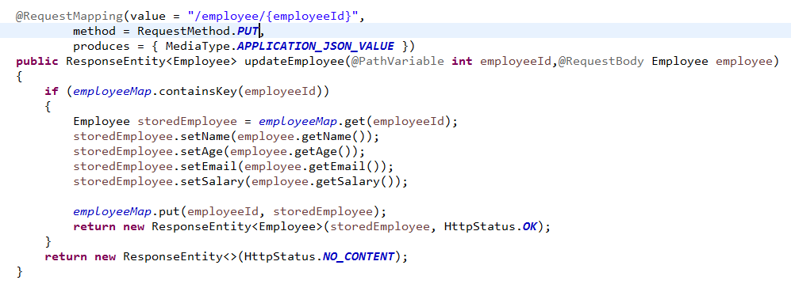
Handle HTTP PUT Request

Slide 2
Handle HTTP PUT Request
https://www.udemy.com/course/restful-web-services-with-spring-framework-a-quick-start/learn/lecture/11780760#overview

